Slide 1
BEHIND THE IMAGES
Akshitha Thokala 160121771072
Buggala Jahnavi 160121771075

Slide 2
CONTENTS
Motivation
Problem Statement
Introduction
Hardware and Software Specifications
Design and Methodology
Algorithm

Slide 3
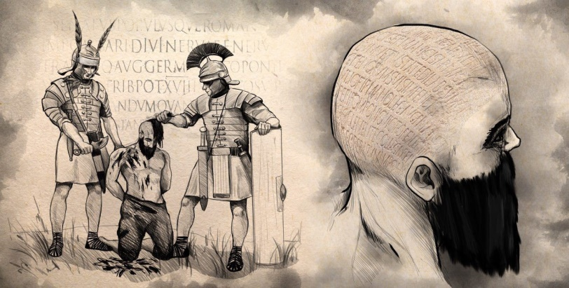

MOTIVATION
In ancient times, steganography was mostly done physically. The oldest documented case of steganography dates to 500 BC, in which Histiaeus, the ruler of Milteus, tattooed a message on the shaved head of one of his slaves and let the hair grow back. He then sent the slave to Aristagoras, his son-in-law, who shaved the slaves head again and revealed the message.
Today, steganography has moved to the digital world.
Steganography provides a platform to hide the existence of a message from a third party, this knowledge of steganography is of increasing importance to individuals in the law enforcement, intelligence, and military communities.

Slide 4

PROBLEM STATEMENT
Steganography hides the very existence of a message so that if successful it generally attracts no suspicion at all. This project deals with hiding text into image files respectively along with password.

Slide 5
INTRODUCTION
The art and science of hiding information by embedding messages within other, seemingly harmless messages. Information can be hidden in carriers such as images, audio files, text files, videos and data transmissions.
One of the most popular techniques is 'least significant bit (LSB) steganography'. In this type of steganography, the information hider embeds the secret information in the least significant bits of a media file.

Slide 6


HARDWARES AND SOFTWARES USED
Hardware Specifications:
Processor: Intel COREi5, 5th Gen
RAM : 8GB
Disk Space: 10GB or more
Software Specifications :
Operating System: Windows 10
Programming Language: Python
Other Applications: Visual Studio Code

Slide 7
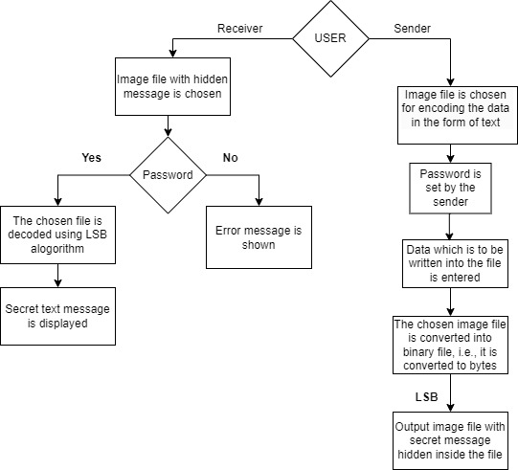
DESIGN & METHODOLOGY
The application is based on the user. Here users are the receiver and sender.
When the user is the sender, the user needs to specify the image file in which he want to hide the message and need to give the secret message. Before this step the user needs to specify the secret password. The secret message is hidden in the file using the LSB method. Now the file is along with the secret file but in binary format. The binary file is again converted back to a normal file using LSB.
When the user is the receiver, first the user needs to enter the password, if the password does not match then error message is shown. If the password matches then the user can get the secret message.

Slide 8

ALGORITHM
We can describe a digital image as a finite set of digital values, called pixels. Pixels are the smallest individual element of an image, holding values that represent the brightness of a given color at any specific point. So we can think of an image as a matrix (or a two-dimensional array) of pixels which contains a fixed number of rows and columns.
Least Significant Bit (LSB) is a technique in which the last bit of each pixel is modified and replaced with the secret message’s data bit.

Slide 9
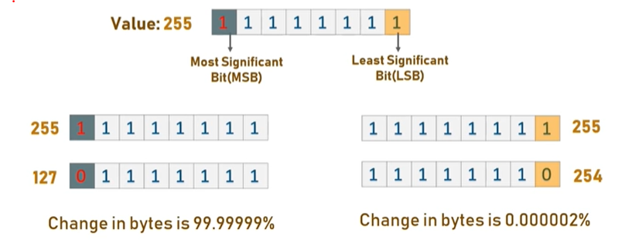
From the image it is clear that, if we change MSB it will have a larger impact on the final value but if we change the LSB the impact on the final value is minimal, thus we use least significant bit steganography.

Slide 10
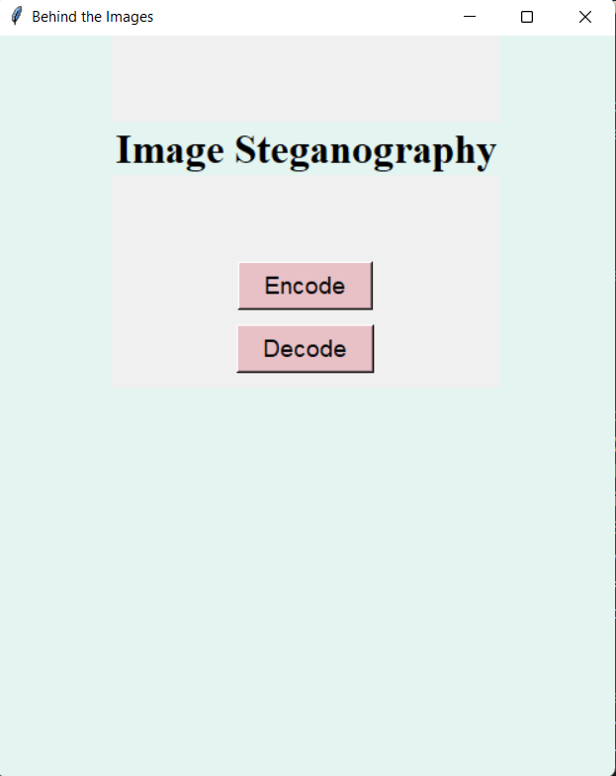
IMPLEMENTATION AND RESULTS
Interface to select the encoding process or decoding process.

Slide 11
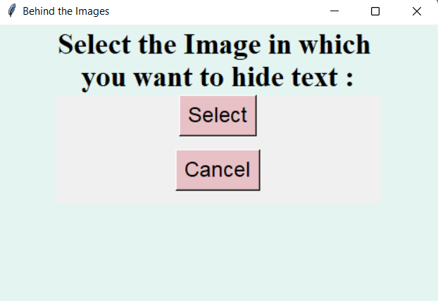
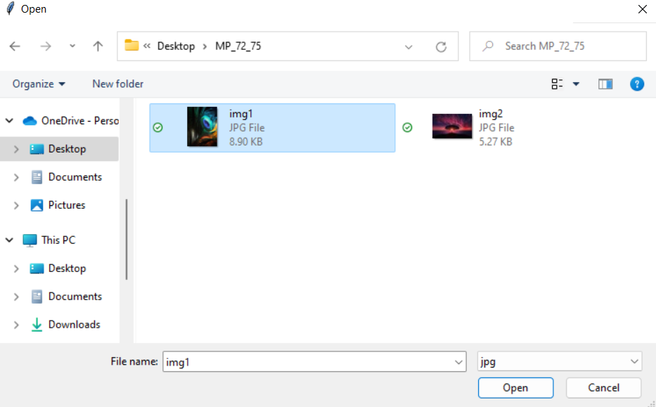
Behind the scenes of encoding
Window for image selection.
Selecting the image from your device.

Slide 12
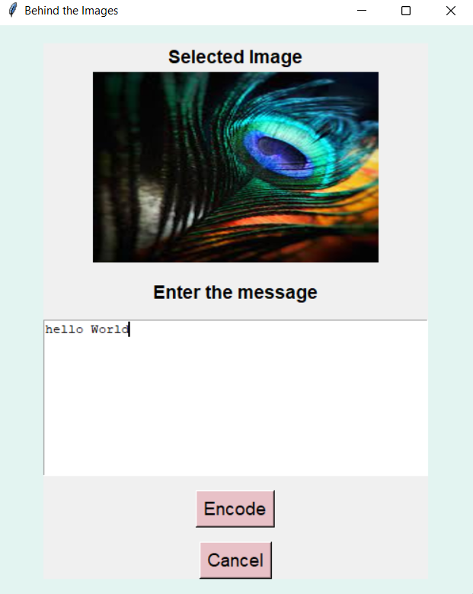
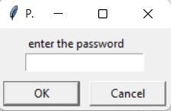
Before Encoding the image set a password.
Enter the Secret information.

Slide 13
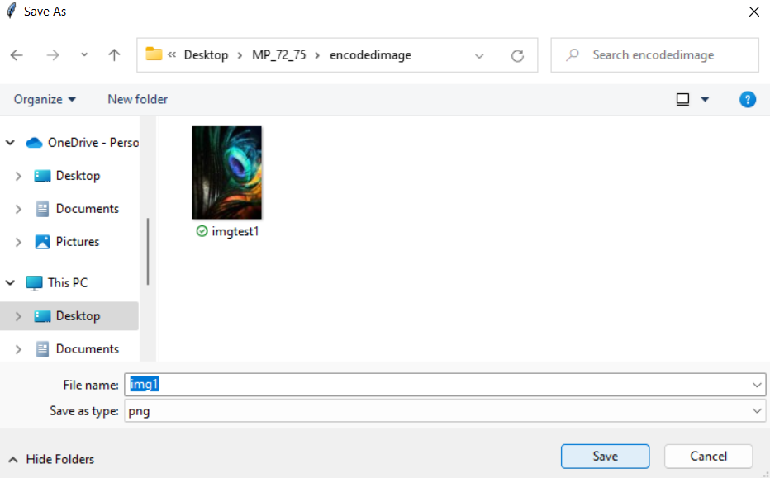
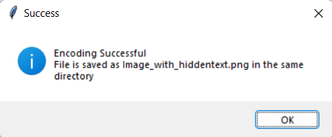
The new encoded image is formed and saved into the desired folder.
Message displayed after encoding.

Slide 14
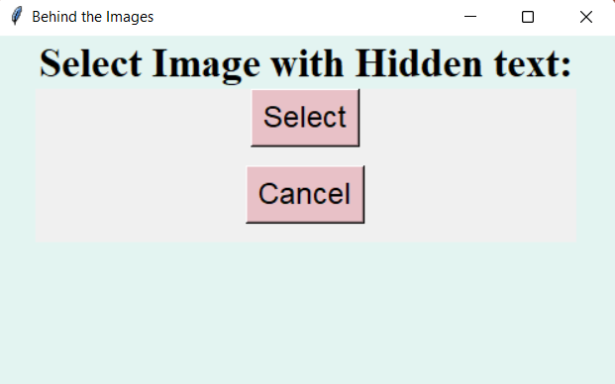
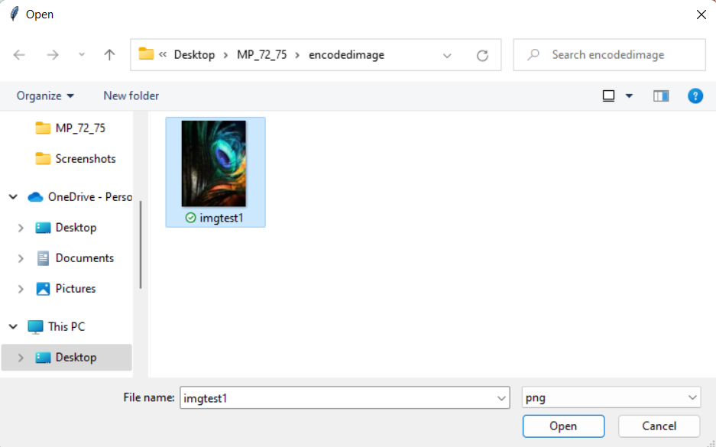
Behind the scenes of Decoding
Window for selecting the hidden text image.
The image which has the hidden message is selected.

Slide 15
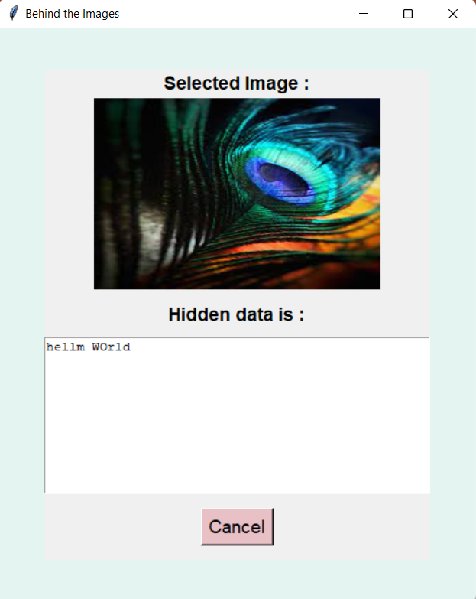
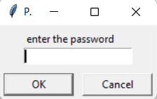
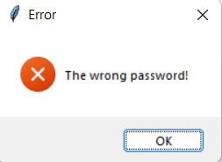
The password given by the user should be correctly entered by the receiver in order to get the hidden text.
If the password entered is Wrong. The below error message is shown.
The secret message is finally revealed out.

Slide 16
FUTURE SCOPE
Advancements in Deep Learning: The use of deep learning techniques in image steganography can improve the security and efficiency of the technique. Neural networks can be trained to identify and extract hidden messages, which can be used to develop more secure steganography algorithms.
Improved Steganalysis Techniques: With the advancements in steganalysis techniques, it has become easier to detect hidden messages in images. Future developments in steganography will focus on developing techniques that are more resistant to detection by steganalysis algorithms.
Integration with Blockchain Technology: The integration of steganography with blockchain technology can provide a secure and tamper-proof method for transferring sensitive information. Steganography can be used to hide information within the blockchain, ensuring that the information is only accessible to authorized users.

Slide 17
CONCLUSION
Image steganography using passwords is a popular technique for hiding secret information within an image. This technique involves the use of a secret password to encrypt the hidden message before embedding it into the image. The password is required to extract the hidden message from the image.
The advantage of using passwords in image steganography is that it provides an extra layer of security, as unauthorized users will not be able to extract the hidden message without the password. This makes the technique more secure compared to other image steganography techniques that do not use passwords.
However, the security of image steganography using passwords depends on the strength of the password. If the password is weak or easily guessable, it can be easily cracked, compromising the security of the hidden message. Therefore, it is important to use strong and complex passwords for image steganography.
In conclusion, image steganography using passwords is a secure technique for hiding secret information within an image. However, the security of the technique depends on the strength of the password used. It is important to use strong passwords to ensure the security of the hidden message.

Slide 18
REFERENCES
https://www.youtube.com/watch?v=xepNoHgNj0w
https://data-flair.training/blogs/python-image-steganography-project/
https://academiccollegeprojects.com/steganography-projects/

